Slide 1
Biodiversity in National Parks

Slide 2
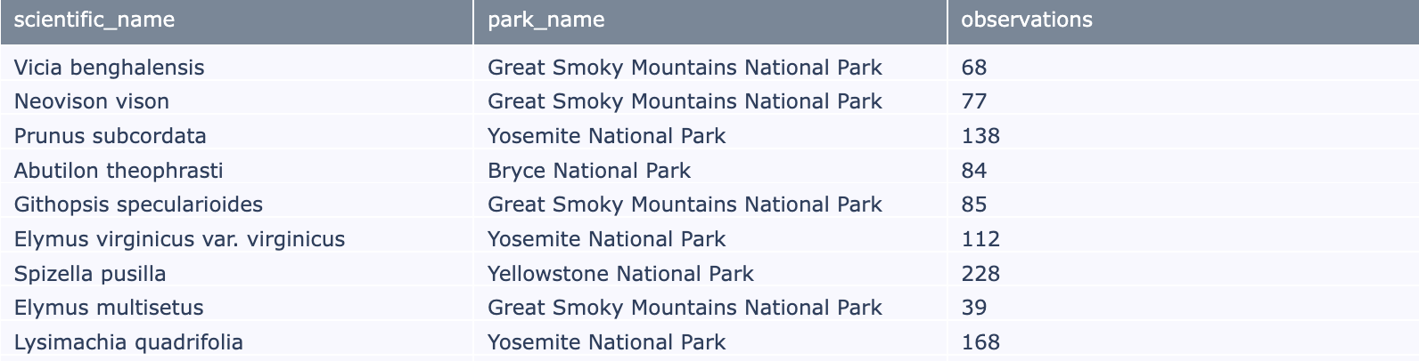
Observations
Below is a table of the first 10 results of the Observations dataset.

Slide 3
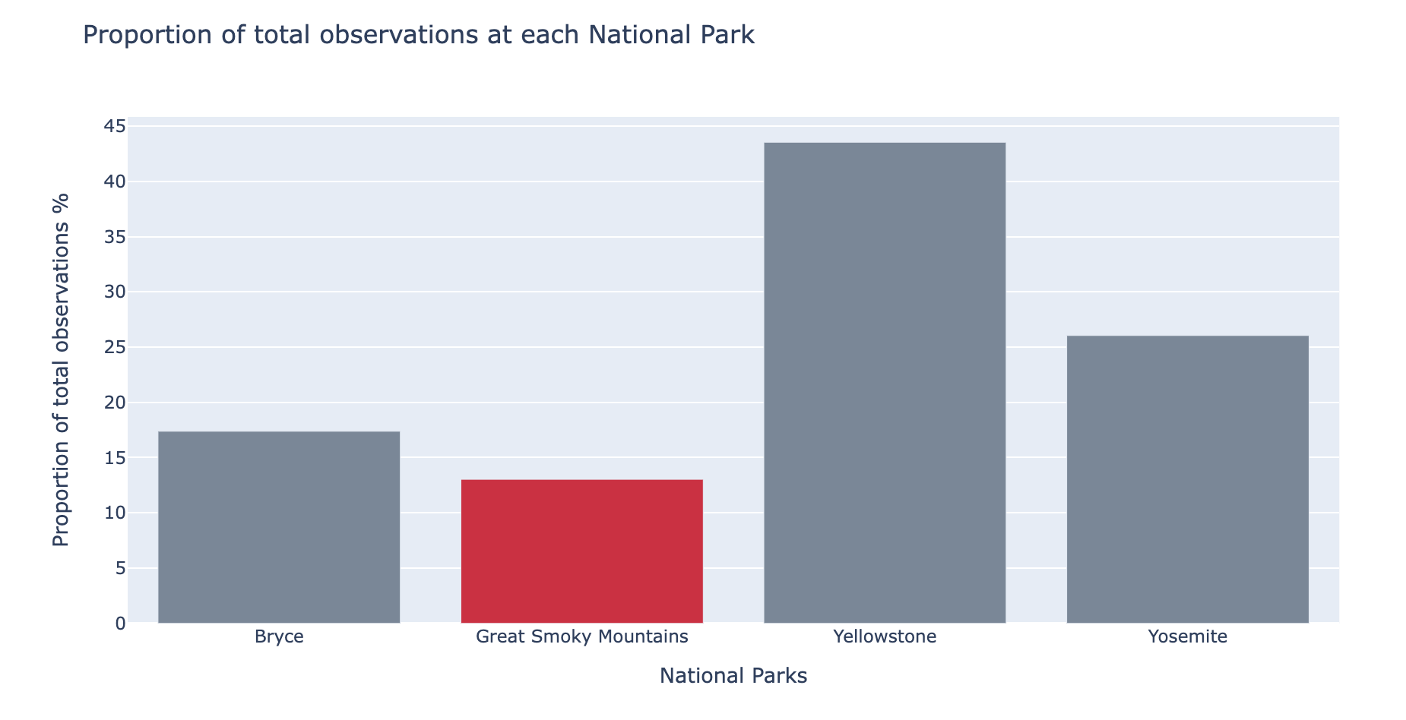

Slide 4
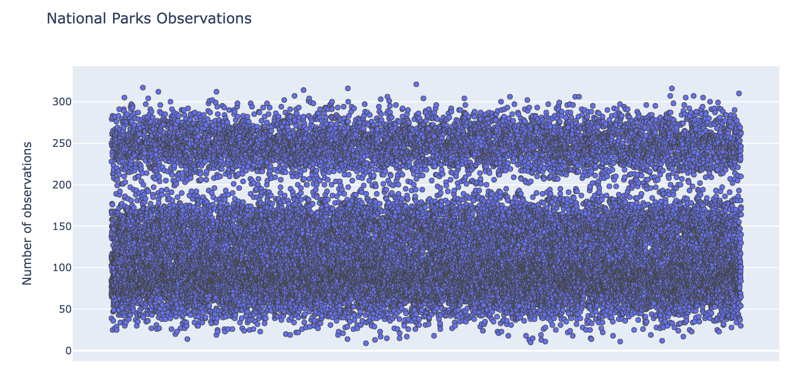

Slide 5
